Slide 1
Model-driven engineering meets formal methods and programming
Klaus Havelund, Rahul KumaR

Slide 2
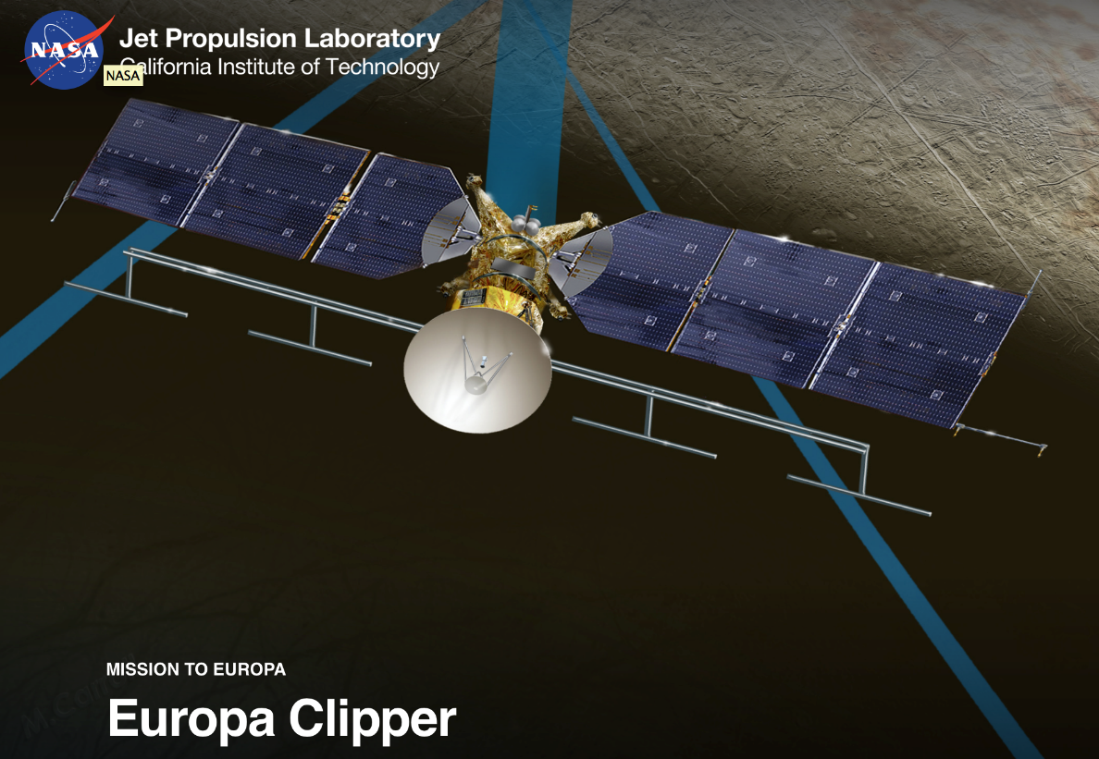
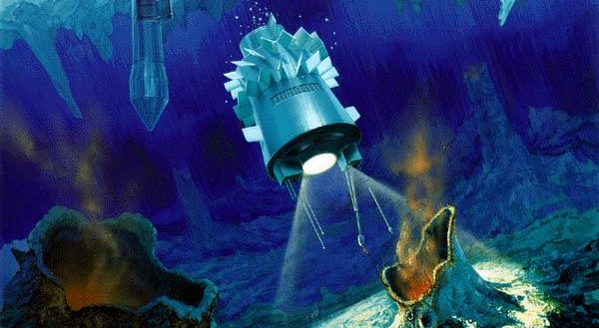
Context of this work The 2020+ JPL mission visiting Jupiter’s moon Europa
Perhaps in some future:

Slide 3


How are missions normally designed?

Slide 4
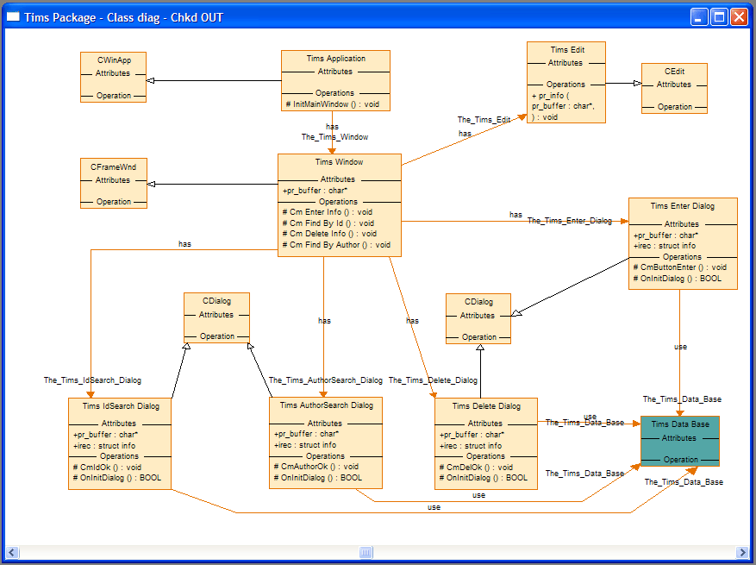

Alterative pursued @ JPL
UML/SysML

Slide 5

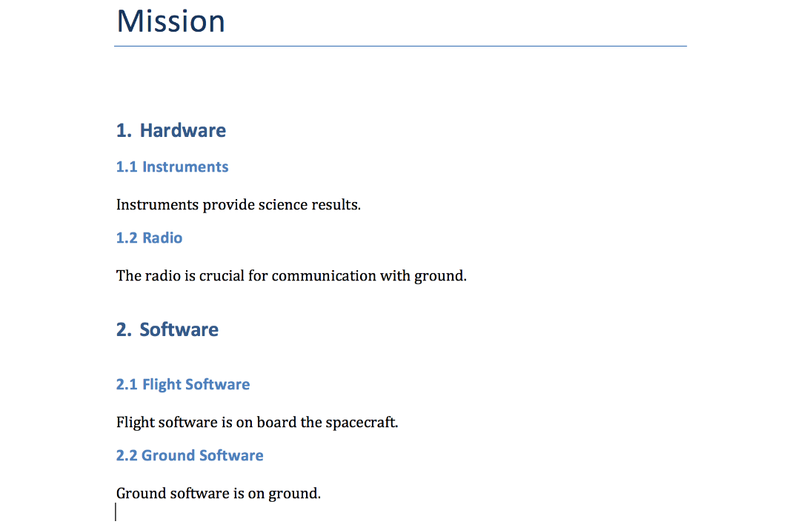
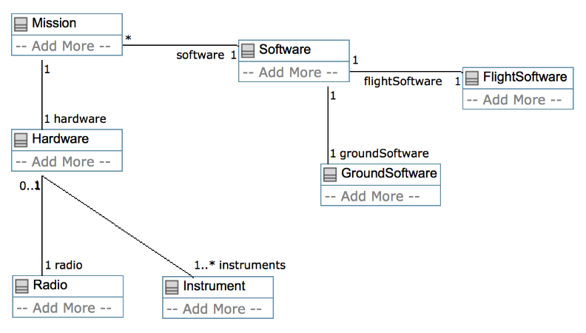
From models to documents

Slide 6

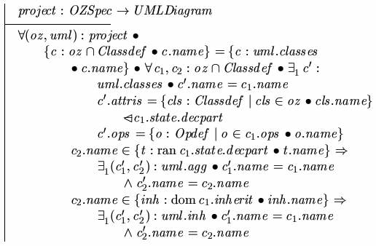
The situation at JPL
popular:
class diagrams + constraints
Model based engineering community @ JPL
UML, SysML, Visual languages
Semantics difficult to find/use
No analysis
Formal methods community @ JPL
Formal and Textual languages
Semantics clearly defined
Analysis (model checking, th. proving, …)

Slide 7
But the goals are similar
model
Create models
Analyze for correctness
Possibly produce implementation
Verify implementation
implementation

Slide 8
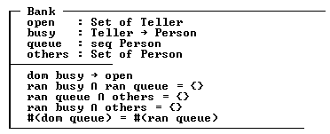
Desire for textual language for class diagrams with constraints
Classes with multiple inheritance
Properties (fields in classes – id : type)
Constraints (predicate logic)
Functions
Should be declarative
Resembling: Z, VDM++, RAISE, PVS, …

Slide 9
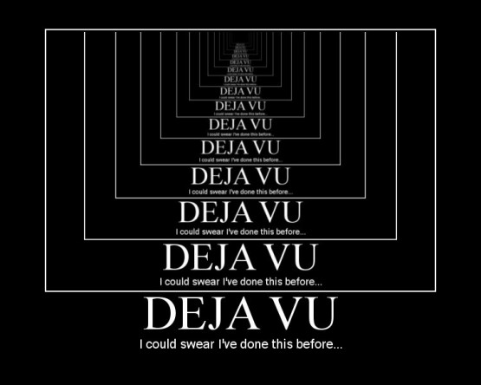

Slide 10
The obvious questions
Why not pick an existing formal specification language?
Why not pick an existing programming language?
Some possible answers that we are still not sure about
Desirable to own the tool stack, full control over syntax, parser, type checker, analysis support.
Keeping it as simple as possible. Scala is complex, for tool builders and for modelers.
Full automation required. No interactive theorem proving.

Slide 11
Additional requirements
A model should be able to analyze itself (full reflection)
A model should be able to analyze versions of itself
One should be able to extend the language
Models are stored in database where each construct is data
Focus on abstract syntax with different syntaxes

Slide 12
class Thing {weight : Int}
class Event {
start : Real
end : Real
req start >= 0.0 && end > start
fun after(e : Event) : Bool {
start >= e.end
}
}
class Instr extends Thing {
power : Real
req power >= 0.0
req weight > 0 && weight <= 1000
}
class SmplRadio extends Instr
class SmrtRadio extends SmplRadio
class SysMngr {
bootUp : Event
initMem : Event
tkPic : Event
req tkPic.after(initMem)
&&
tkPic.after(bootUp)
}
class SpaceCraft extends Thing {
instrWeight : Real
radio : Instr
camera : Instr
software : SysMngr
req instrWeight =
radio.weight + camera.weight
req notTooHeavy: instrWeight <= 999
}
ShRaan : SpaceCraft

Slide 13
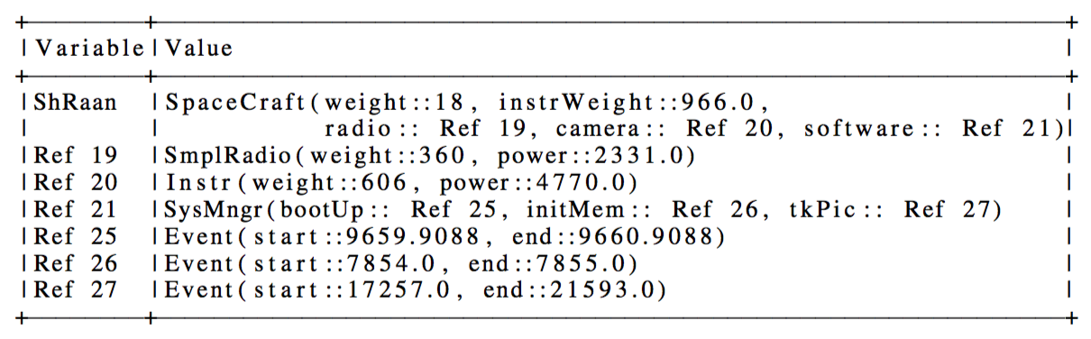
Result (solution computed by Z3)

Slide 14
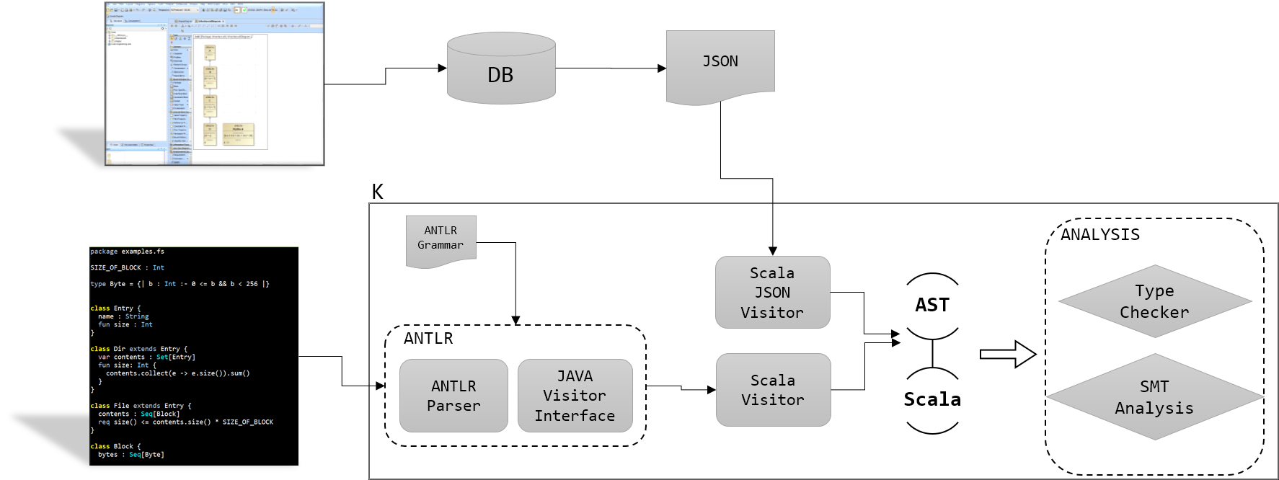

Slide 15
(declare-datatypes () ((Thing
(mk-Thing (weight Int)))))

Slide 16

class A { class B {
b : B a : A
} }
(declare-datatypes () (
(A (mk-A (b B)))
(B (mk-B (a A))))
)

Slide 17
(define-sort Ref () Int)
(declare-const heap (Array Ref Any))
(define-fun deref ((ref Ref)) Any
(select heap ref))
(declare-datatypes () ((SpaceCraft
(mk-SpaceCraft
(weight Int)
(instrWeight Real)
(radio Ref)
(camera Ref)
(software Ref)))))
(define-fun deref-is-Instr ((this Ref)) Bool
(is-lift-Instr (deref this)))
(define-fun deref-isa-Instr ((this Ref)) Bool
(or
(deref-is-Instr this)
(deref-is-SmplRadio this)
(deref-is-SmrtRadio this)))
(declare-datatypes () ((Any
(lift-Thing (sel-Thing Thing))
(lift-Instr (sel-Instr Instr))
(lift-SpaceCraft (sel-SpaceCraft SpaceCraft))
...
null)))
(define-fun deref-Instr ((this Ref)) Instr
(sel-Instr (deref this)))

Slide 18
(define-fun Instr!weight ((this Ref)) Int
(weight (deref-Instr this)))
(define-fun Instr.weight ((this Ref)) Int
(ite (deref-is-Instr this)
(weight (deref-Instr this))
(ite (deref-is-SmplRadio this)
(weight (deref-SmplRadio this))
(weight (deref-SmrtRadio this))
)))
(define-fun Event.after ((this Ref)(e Ref)) Bool
(>= (Event.start this) (Event.end e)))

Slide 19
class Thing {weight : Int}
class Event {
start : Real
end : Real
req start >= 0.0 && end > start
fun after(e : Event) : Bool {
start >= e.end
}
}
class Instr extends Thing {
power : Real
req power >= 0.0
req weight > 0 && weight <= 1000
}
class SmplRadio extends Instr
class SmrtRadio extends SmplRadio
class SysMngr {
bootUp : Event
initMem : Event
tkPic : Event
req tkPic.after(initMem)
&&
tkPic.after(bootUp)
}
class SpaceCraft extends Thing {
instrWeight : Real
radio : Instr
camera : Instr
software : SysMngr
req instrWeight =
radio.weight + camera.weight
req notTooHeavy: instrWeight <= 999
}
ShRaan : SpaceCraft

Slide 20
(define-fun SysMngr.inv ((this Ref)) Bool
(and
(deref-isa-Event (SysMngr!bootUp this))
(deref-isa-Event (SysMngr!initMem this))
(deref-isa-Event (SysMngr!tkPic this))
(and
(Event.after (SysMngr!tkPic this) (SysMngr!initMem this))
(Event.after (SysMngr!tkPic this) (SysMngr!bootUp this)))))
(assert (exists ((this Ref))
(deref-is-SysMngr this)))
(assert (forall ((this Ref))
(=>
(deref-is-SysMngr this)
(SysMngr.inv this))))
333 lines of SMT generated

Slide 21
Types
Primitive types: Int, Real, Bool, String
Class types: Instr
Collections: Set[Instr], Oset[Instr], Bag[Instr], Seq[Instr]
Tuples: Instr * Int * Bool
Functions: Instr -> Int
Predicate subtypes: {| x : Int :- x >= 0 |}

Slide 22
Expressions
x, radio.power.max
1, 3.53, false, “MSL”
1 + 3, x isin s, s subset t, !b
instrument is Radio
Tuple(radio,42,false)
f(42)
if x > 0 then x – 1 else x
forall x : Int :- exists y : Int :- x + y = 0
Set{1,2,3}, Set{1 .. 3}, Set{f(x) | x : Int :- p(x)}
{sum1 : Int = x + y
sum2 : Int = p + q
if sum1 < sum2 then sum1 else sum2
}

Slide 23
Programming in K
class PowerSource {
power : Int
fun add(amount: Int)
pre amount > 0
post power > power~
{
power = power + amount
}
}
Syntax is there but no solving support.
Users do not agree whether they want it.

Slide 24
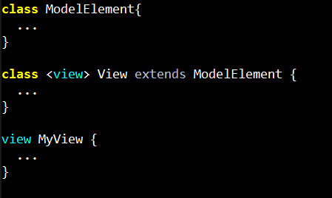
Extensible Keywords
You can use view instead of class.
This is the same as writing
class MyView extends View {

Slide 25
Domains
Domain specific information encoded in K libraries
For example:
SysML can now be completely encoded in SysMl.k, which can be used as and when needed
Examples of other domains:
UML
Physics
Mechanical
…
Libraries
SysML
Mechanical
...
Europa

Slide 26
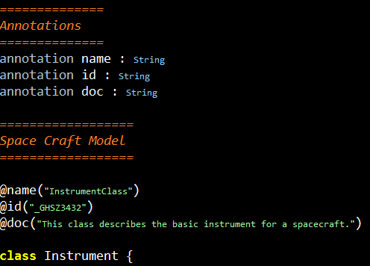
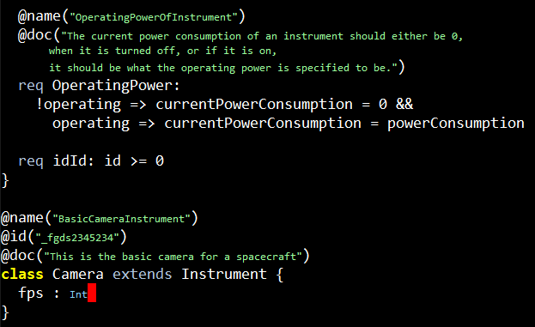
Annotations

Slide 27
Analysis
K Model
Parsing √
Conversion to AST √
Custom syntactic checking
Formal analysis
Solving
to SMT √
to BAE
to <your favorite solver ☺>
Function proofs
Class consistency √
Model checking
Domain specific rules
User defined rules
Concrete Execution
Documentation
Latex √
Type Checking √

Slide 28
Examples and Demo

Slide 29
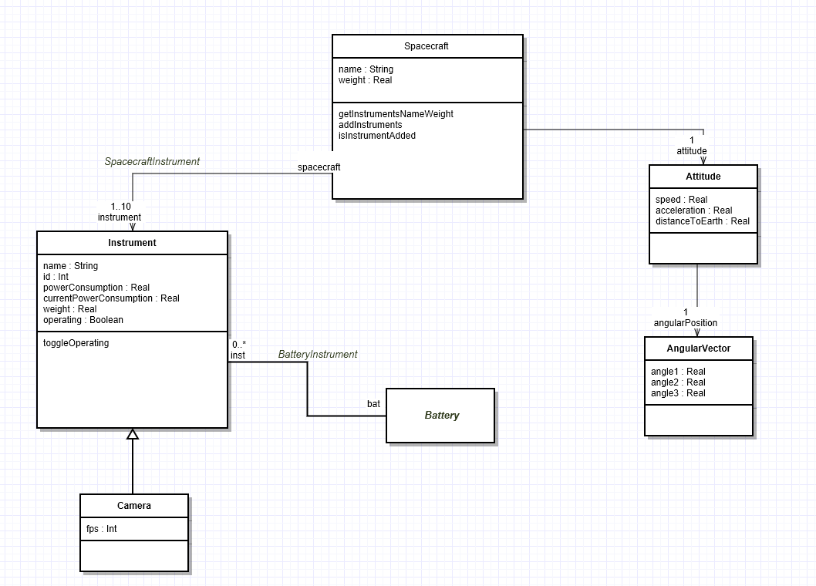
Spacecraft Example

Slide 30
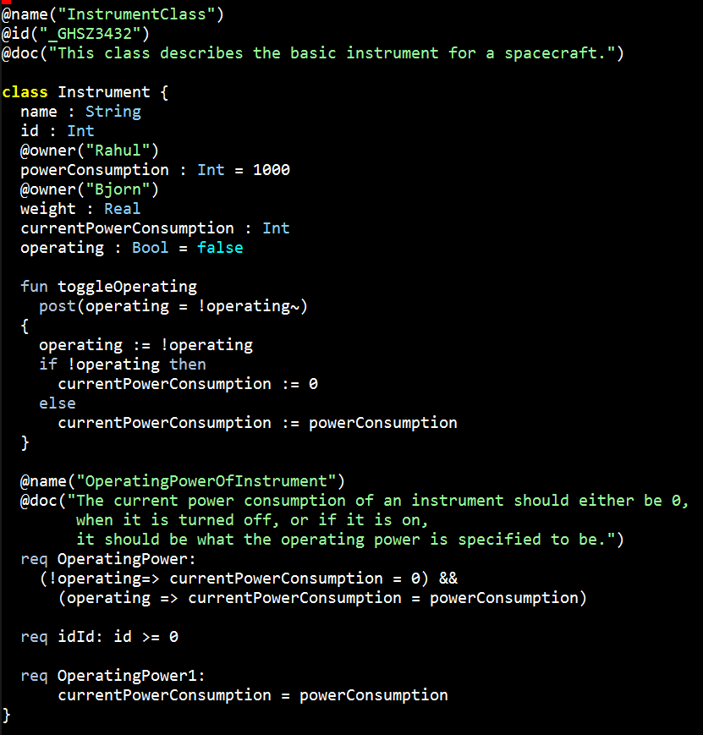
Spacecraft Example

Slide 31
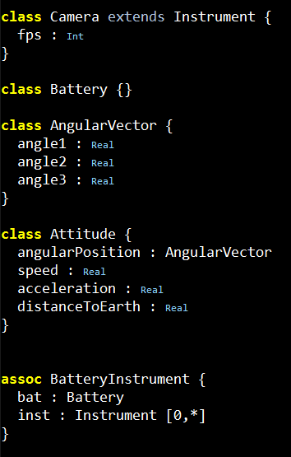
Spacecraft Example

Slide 32
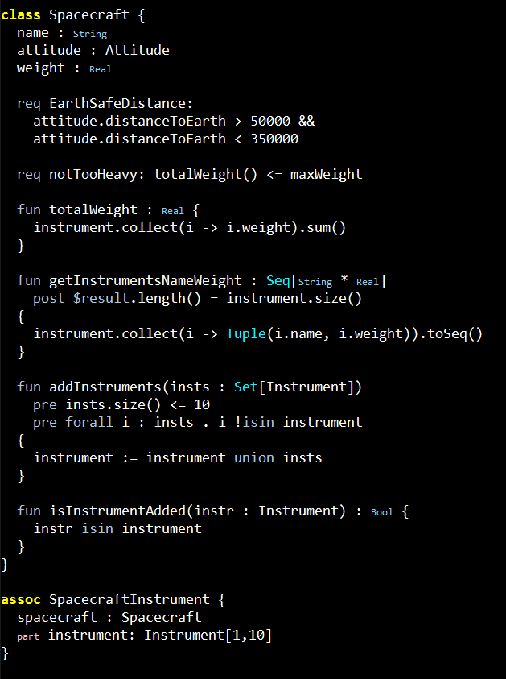
Spacecraft Example

Slide 33
Shapes
Right Triangle
(one angle at 90º)
Equilateral Triangle
(three sides equal)
Isosceles Triangle
(two sides equal)
Square
Rectangle
(all sides equal)
Rectangle
(two sides equal)
Check class consistency using K. Properties of shapes encoded as constraints.
Sum of angles in triangle is 180º

Slide 34
State machine
turn_on
fire
off
ready
firing
turn_off

Slide 35
State machine
turn_on
5
fire
4
2
3
0
off
ready
firing
1
turn_off

Slide 36
State machine
turn_on
5
fire
4
Defect 1
A modeler introduces a transition that takes the state machine from ready to off position when a fire command is issued. This makes the state machine non-deterministic, which is caught by K.
2
3
0
off
ready
firing
fire
4
turn_off
1

Slide 37
State machine
turn_on
5
fire
4
Defect 2
Due to a miscommunication between modelers, it was thought that when the rocket is turned off from the firing state, it will go back to the ready state. Again, the state machine becomes non-deterministic, which is caught by K.
2
3
0
off
ready
firing
turn_off
1
turn_off
1

Slide 38
Scheduler
Only specify partial order for a timeline.
establish_clock
init_evr
boot
evr_service_start
power_off_cameras
Not together
power_on
pick_boot_image
mount_flash
power_on_star_sensor
power_on_navigation

Slide 39
Single Artifact
Documentation
Produce a single artifact…
K provides infrastructure and automation for the rest
The common language for all tasks.
Analysis/Solving
K Model
Execution
Querying

Slide 40
OCLInEcore
The UML/SysML’s COMMUNITY’s own contribution
to a textual language - Recent work

Slide 41
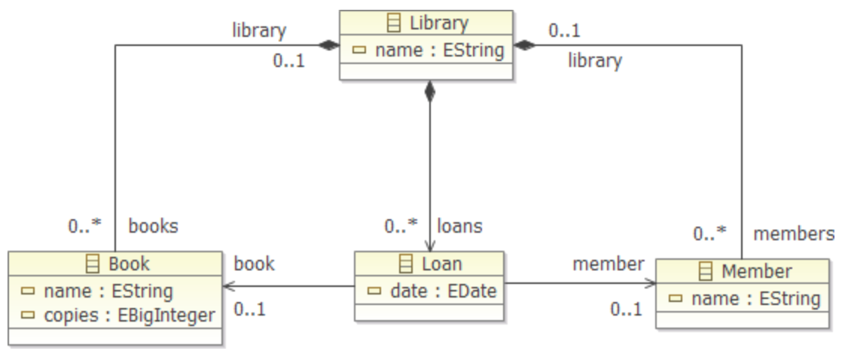

Slide 42
class Library
{
attribute name : String;
property books#library : Book[*] { composes };
property loans : Loan[*] { composes };
property members#library : Member[*] { composes };
}

Slide 43
class Book
{
invariant SufficientCopies:
library.loans->select(book=self)->size() <= copies;
attribute name : String;
attribute copies : Integer;
property library#books : Library[?];
property loans : Loan[*] { derived }
{
derivation: library.loans->select(book=self);
}
operation isAvailable() : Boolean[?]
{
body: loans->size() < copies;
}
}

Slide 44
class Member
{
invariant AtMostTwoLoans: loans->size() <= 2;
invariant UniqueLoans: loans->isUnique(book);
attribute name : String;
property library#members : Library[?];
property loans : Loan[*] { derived }
{
derivation: library.loans->select(member=self);
}
property books : Book[*] { derived,!unique }
{
derivation: loans->collect(book);
}
}

Slide 45
class Loan
{
property book : Book;
property member : Member;
attribute date : ecore::EDate[?];
}

Slide 46
Scala
Using an object oriented + functional programming language for modeling

Slide 47
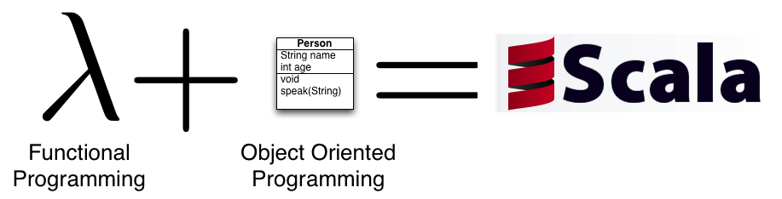
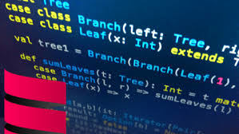
Programming languages
Programming languages
Modern programming languages moving in the direction of spec L.
Combining object oriented and functional programming
Supporting collections, such as sets, lists and maps

Slide 48
Many similarities

Slide 49

class Book
{
invariant SufficientCopies:
library.loans->select(book=self)->size() <= copies;
attribute name : String;
attribute copies : Integer;
property library#books : Library[?];
property loans : Loan[*] { derived,volatile }
{
derivation: library.loans->select(book=self);
}
operation isAvailable() : Boolean[?]
{
body: loans->size() < copies;
}
}
class Book {
invariant ("SufficientCopies") {
library.loans.filter(_.book eq this).size <= copies
}
var name: String
var copies: Integer
var library: Library
def loans: Set[Loan] =
library.loans.filter(_.book eq this)
def isAvailable(): Boolean =
loans.size < copies
}

Slide 50
object Util {
type Constraint = Unit => Boolean
var constraints: List[(String, Constraint)] = Nil
def invariant(c: => Boolean) {
constraints ::= ("", (Unit => c))
}
def invariant(name: String)(c: => Boolean) {
constraints ::= (name, (Unit => c))
}
def evaluate() {
for ((n, c) <- constraints) assert(c(), n)
}
}
import Util._
…

Slide 51
Question
Are the differences between modeling and programming languages big enough to keep them separate?

Slide 52
Thanks for listening

